Slide 1

HYDRA - Swarm Robotics
ENPM808X - Final Project
Sameer Arjun S
Manav Nagda
Ishaan Parikh

Slide 2
Introduction
Acme Robotics aims to revolutionize fire response systems within warehouse facilities susceptible to fire incidents by introducing ”Project Hydra” a swarm of turtle bots designed to effectively contain and address fire emergencies. This innovative solution utilizes a fleet of 20 turtlebots equipped with fire hydrant spraying capabilities to encircle and contain fire outbreaks within warehouse environments.
The Hydra project employs robots which are designed to respond autonomously to fire emergencies within the facility. In the event of a fire outbreak, the system receives input specifying the affected machine and later the robots approach the destination and form the optimal shape of surroundings in shapes of square, circle or triangle.

Slide 3
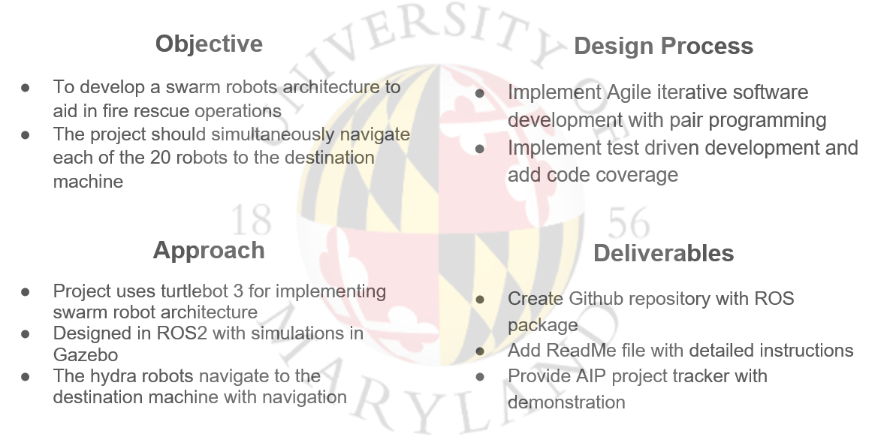
ENPM808X - Final Project - HydraBot

Slide 4
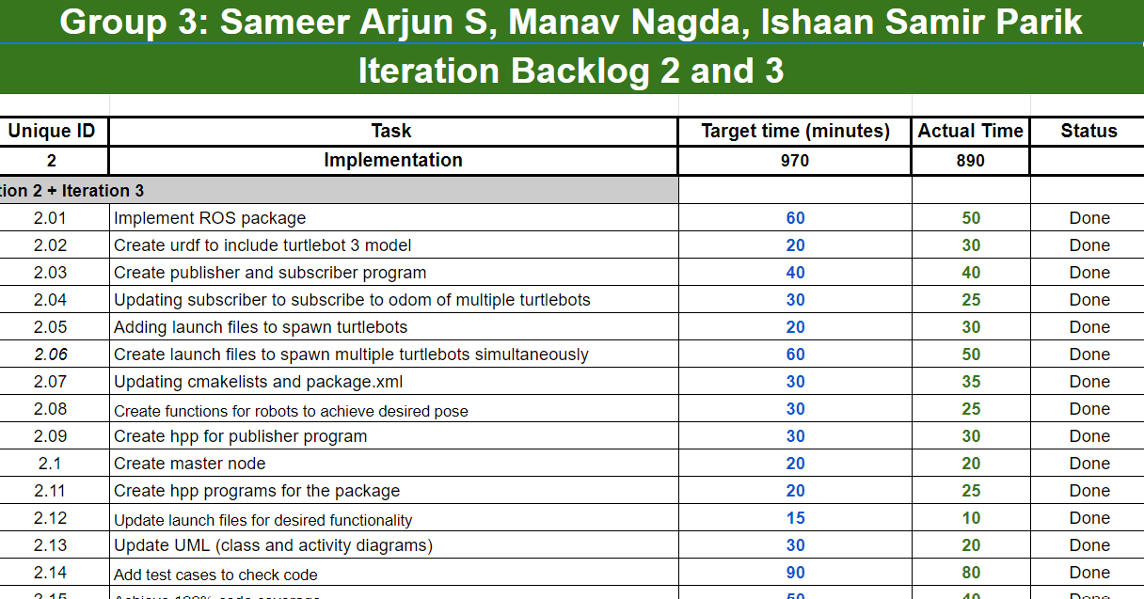
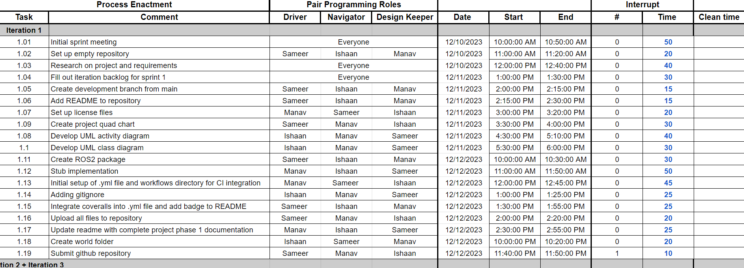
Design & Development
The programming language is C++ for its flexibility and compatibility with ROS 2 humble.
Software developed using to Agile Iterative Planning for project into sprints focusing on key functionalities and testing at each iteration.

Slide 5
Design and Development
The integration of a heuristic mechanism preventing robots from following similar paths, coupled with the implementation of the Rapidly-exploring Random Tree (RRT) algorithm for path planning, stands as a pivotal strategy.
This entails creating dedicated C++ classes for RRT-based path planning within ROS 2 nodes, alongside designing and incorporating a heuristic function considering past paths or covered areas. As the system generates paths using RRT, the heuristic guides path selection, ensuring diverse trajectories for individual turtlebots.

Slide 6
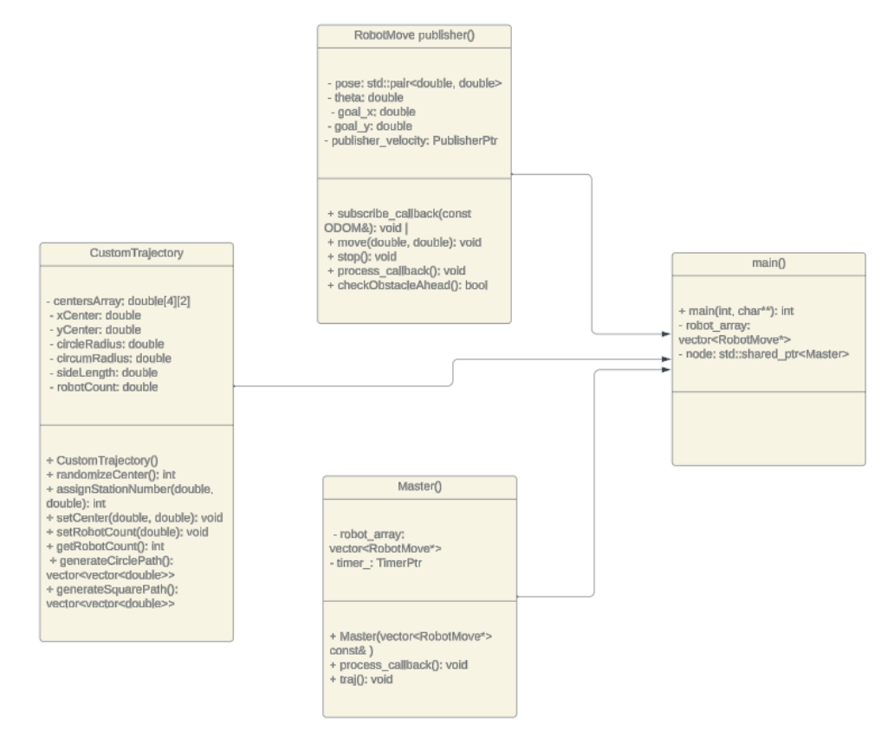



Class Diagram

Slide 7
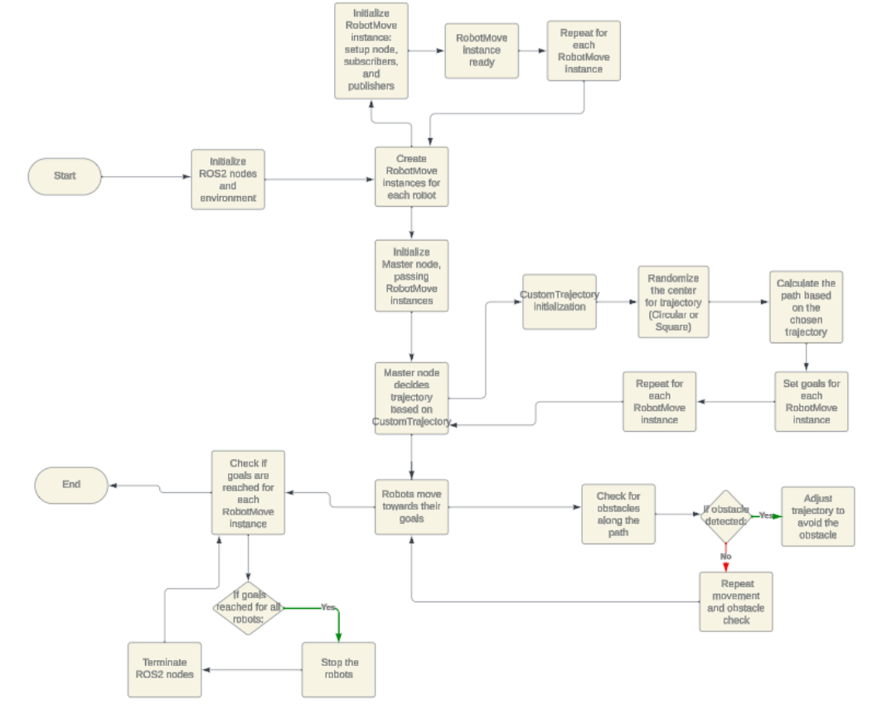
Activity Diagram

Slide 8
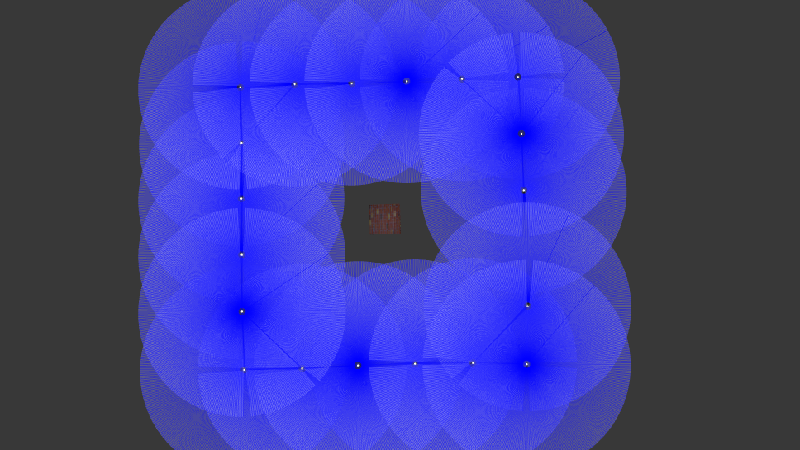
Final Results and Demo
Video Link

Slide 9
Challenges faced
Co-ordination with multiple Turtlebots synchronously
Obstacle avoidance with 20 turtlebots and other obstacles reduces the the real time factor drastically.(1 or 2 always spun randomly)
Creating and Importing custom world files
Trajectory optimization

Slide 10
Thank You!!

